Slide 1
RIP
-community ecology project
-GBS project
-spatial analysis
-Host-associated differentiation project

Slide 2
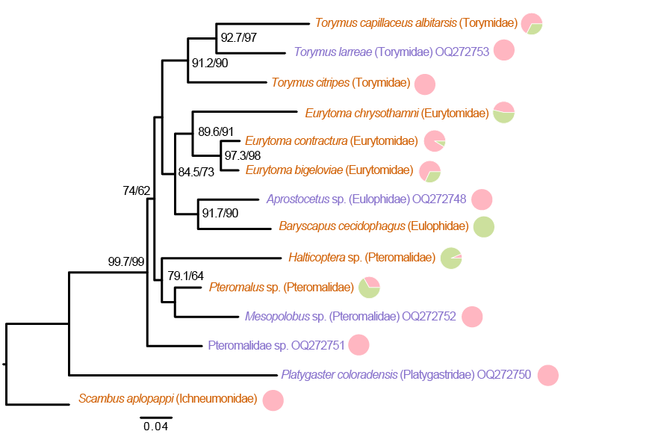
Community/enemy project

Slide 3
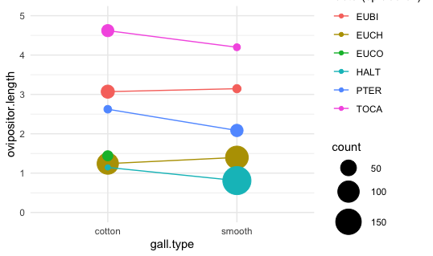
Community/enemy project

Slide 4
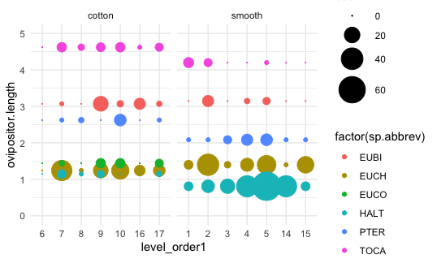
Community/enemy project

Slide 5
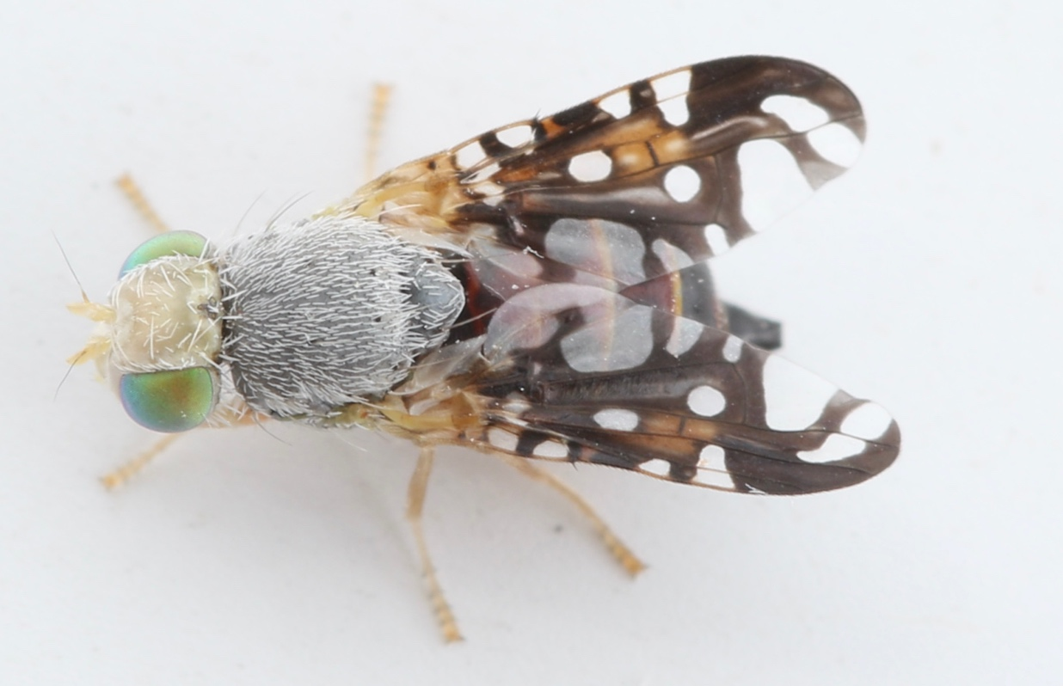
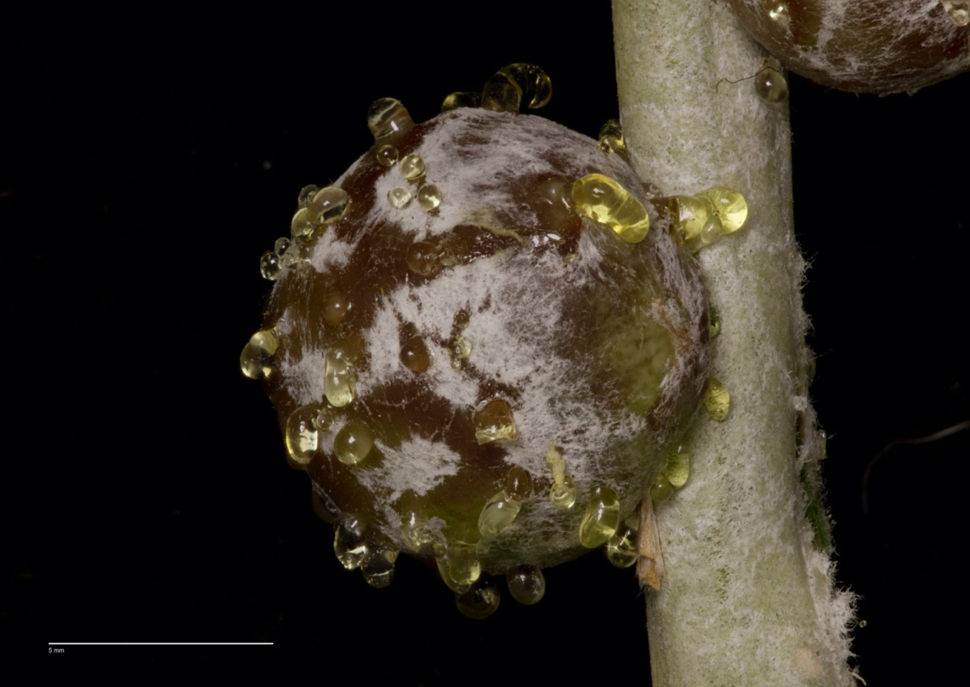

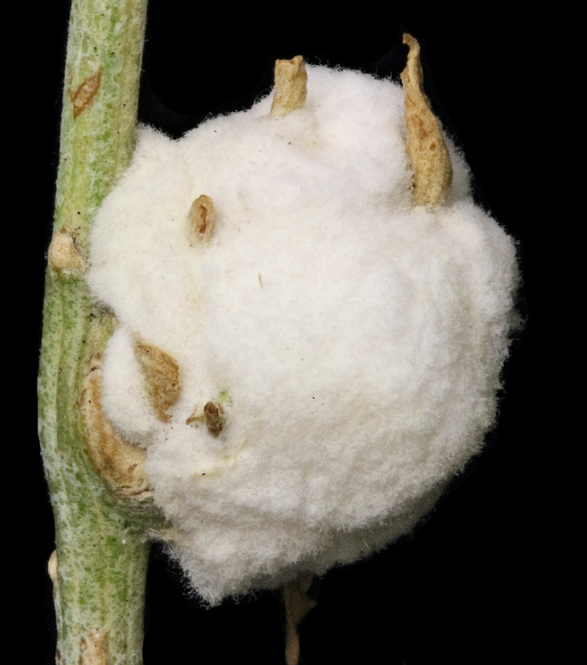

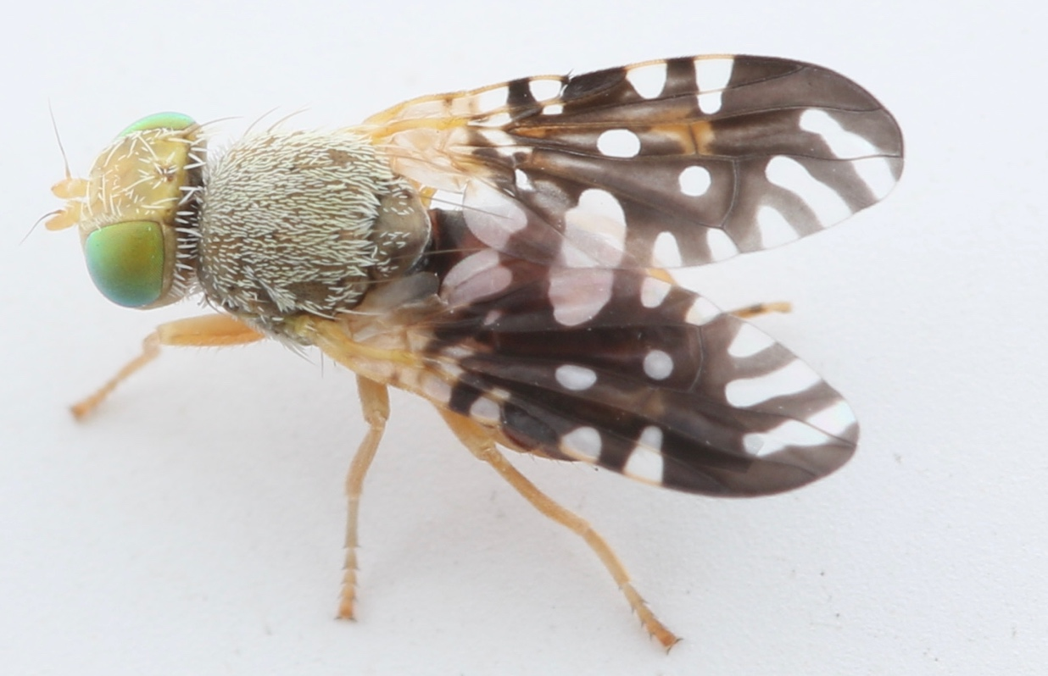
Co-evolution
Aciurina trixa
Aciurina bigeloviae

Slide 6
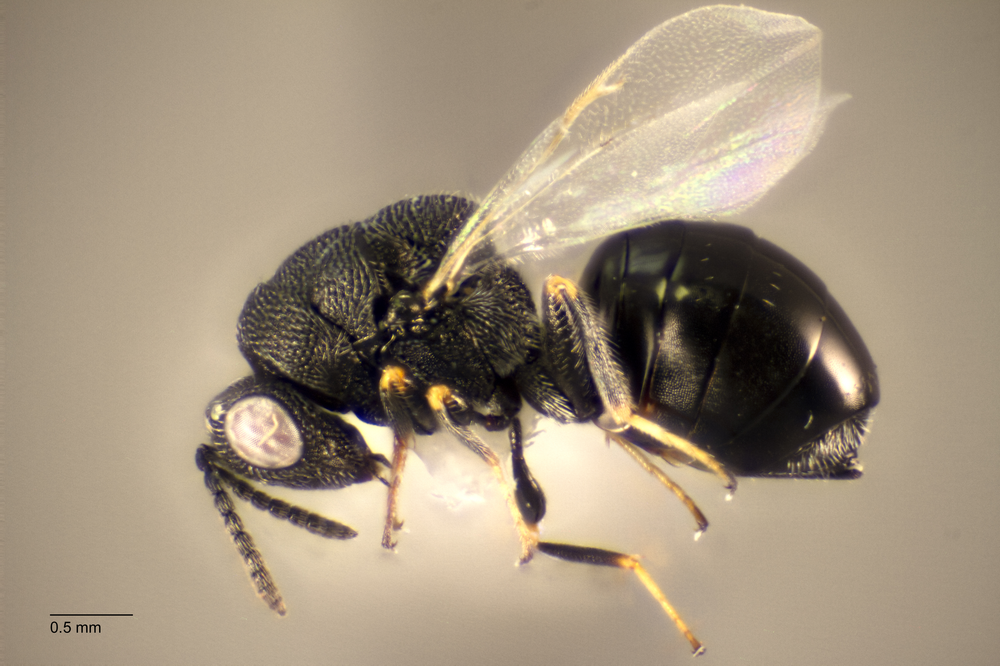
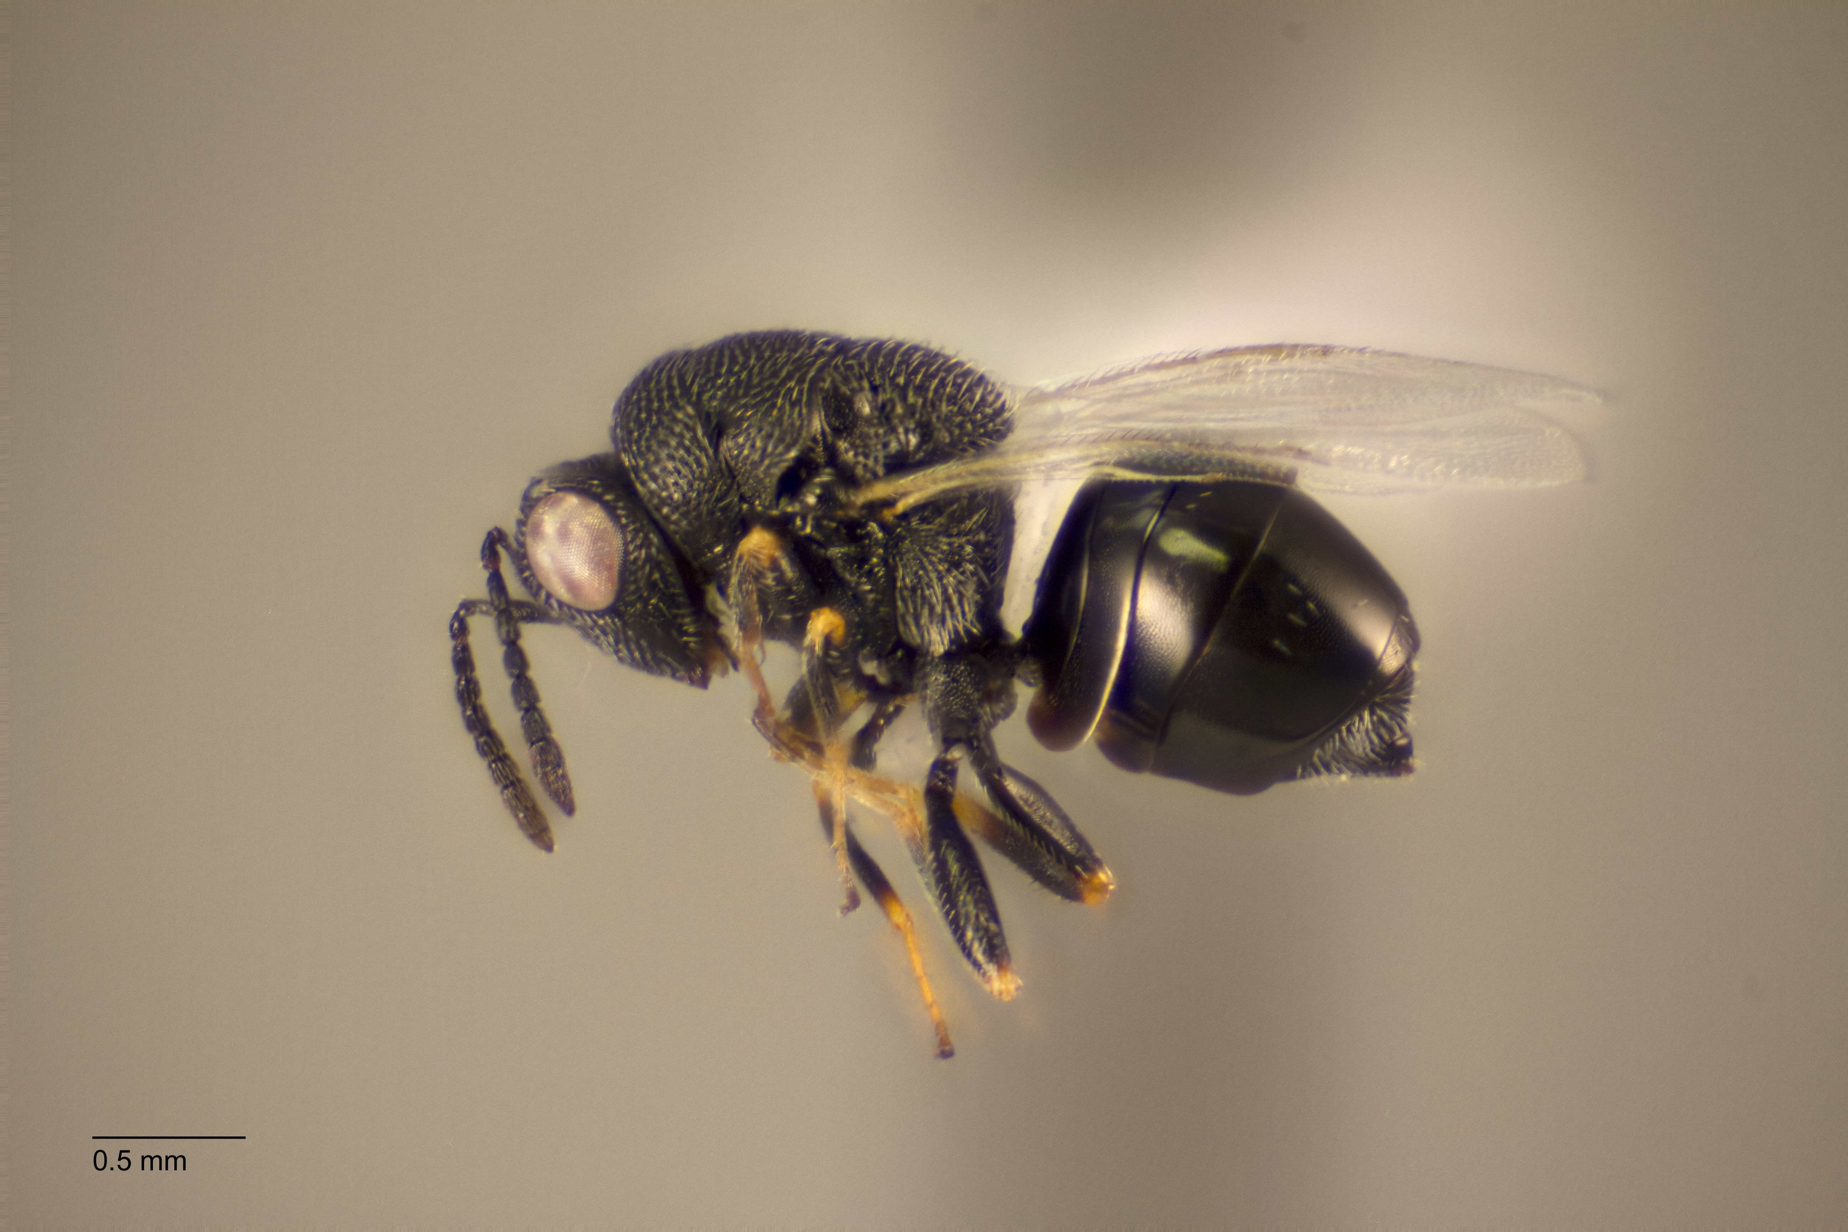
Co-evolution
Host-Associated Differentiation
Aciurina trixa
Aciurina bigeloviae

Slide 7
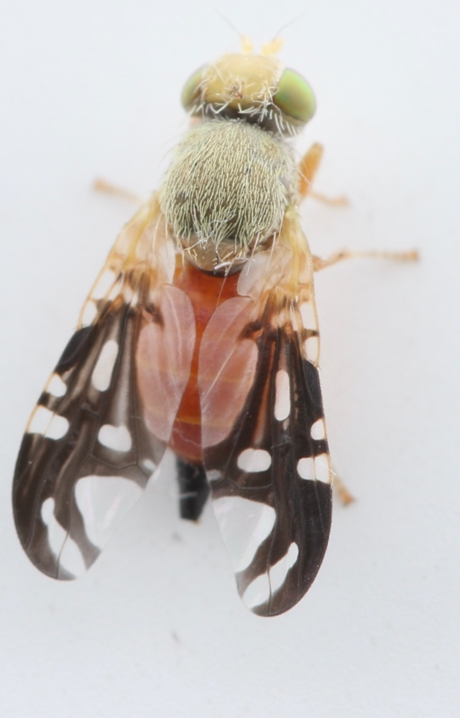
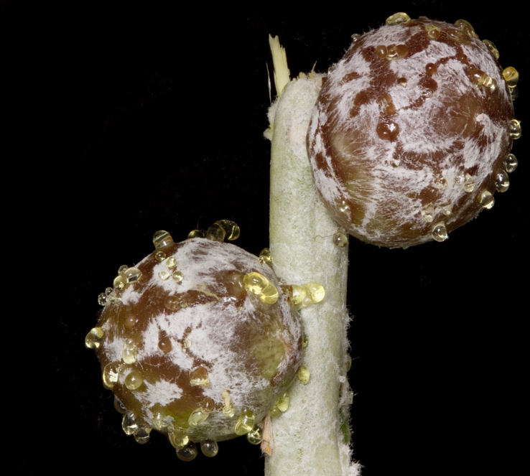

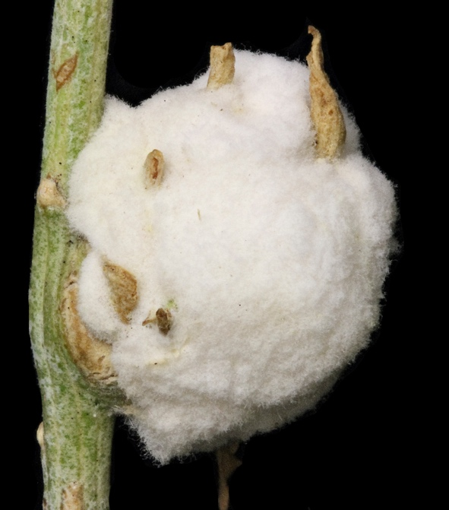
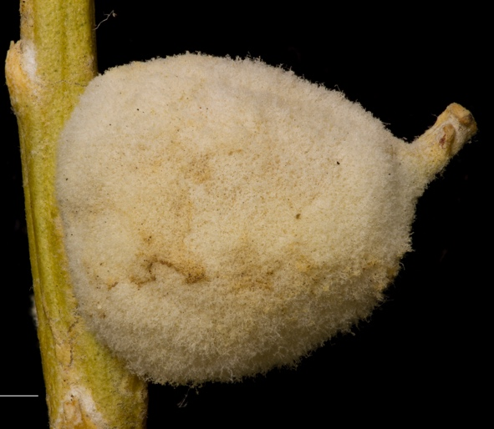

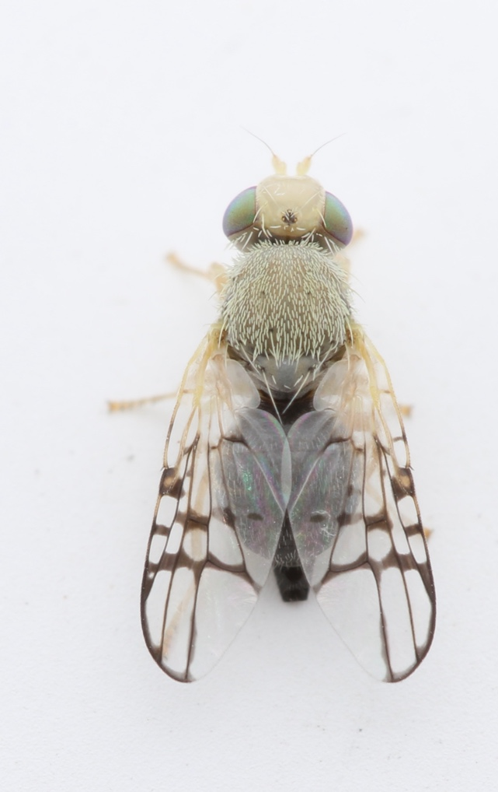
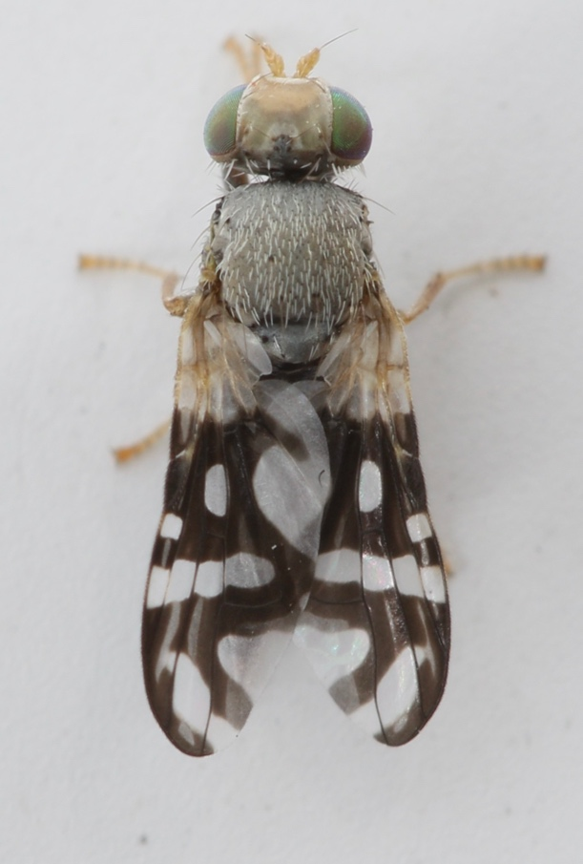
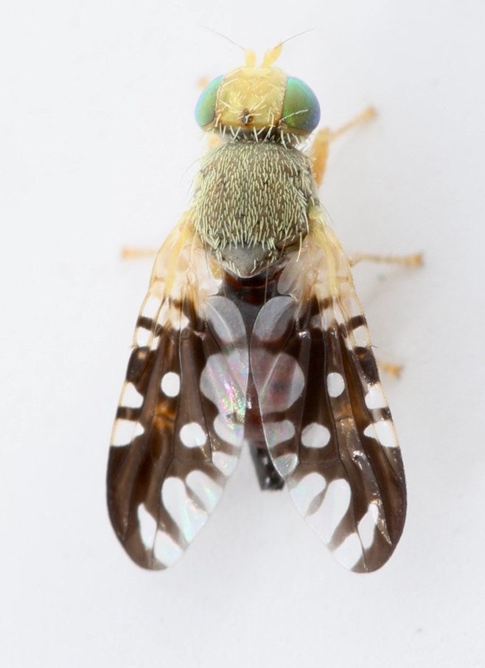
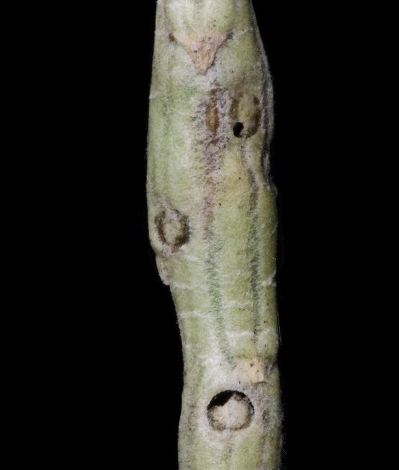
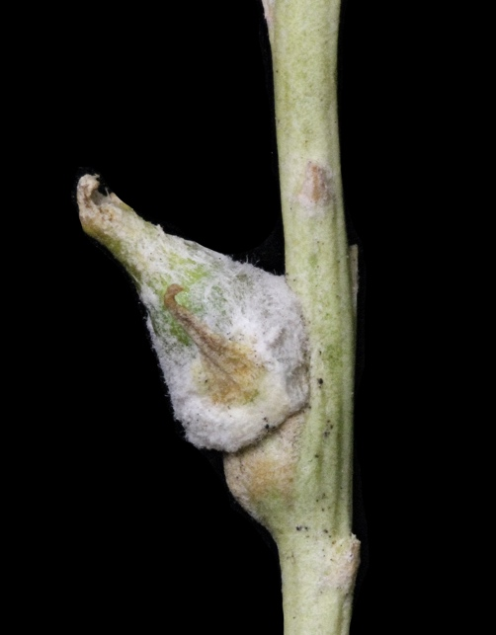
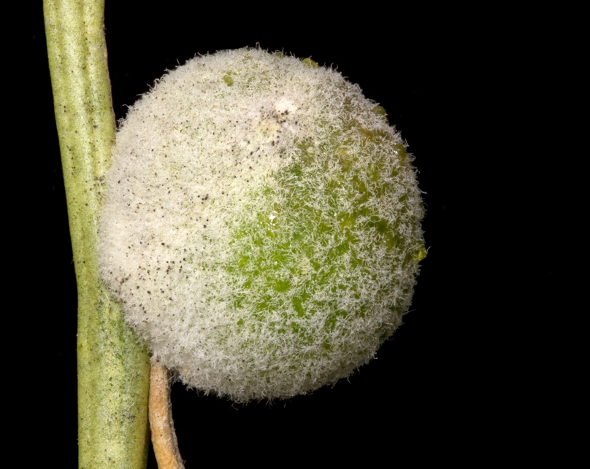
A. trixa
A. bigeloviae
(marshmallow)
A. opaca
(finial)
A. notata

Slide 8
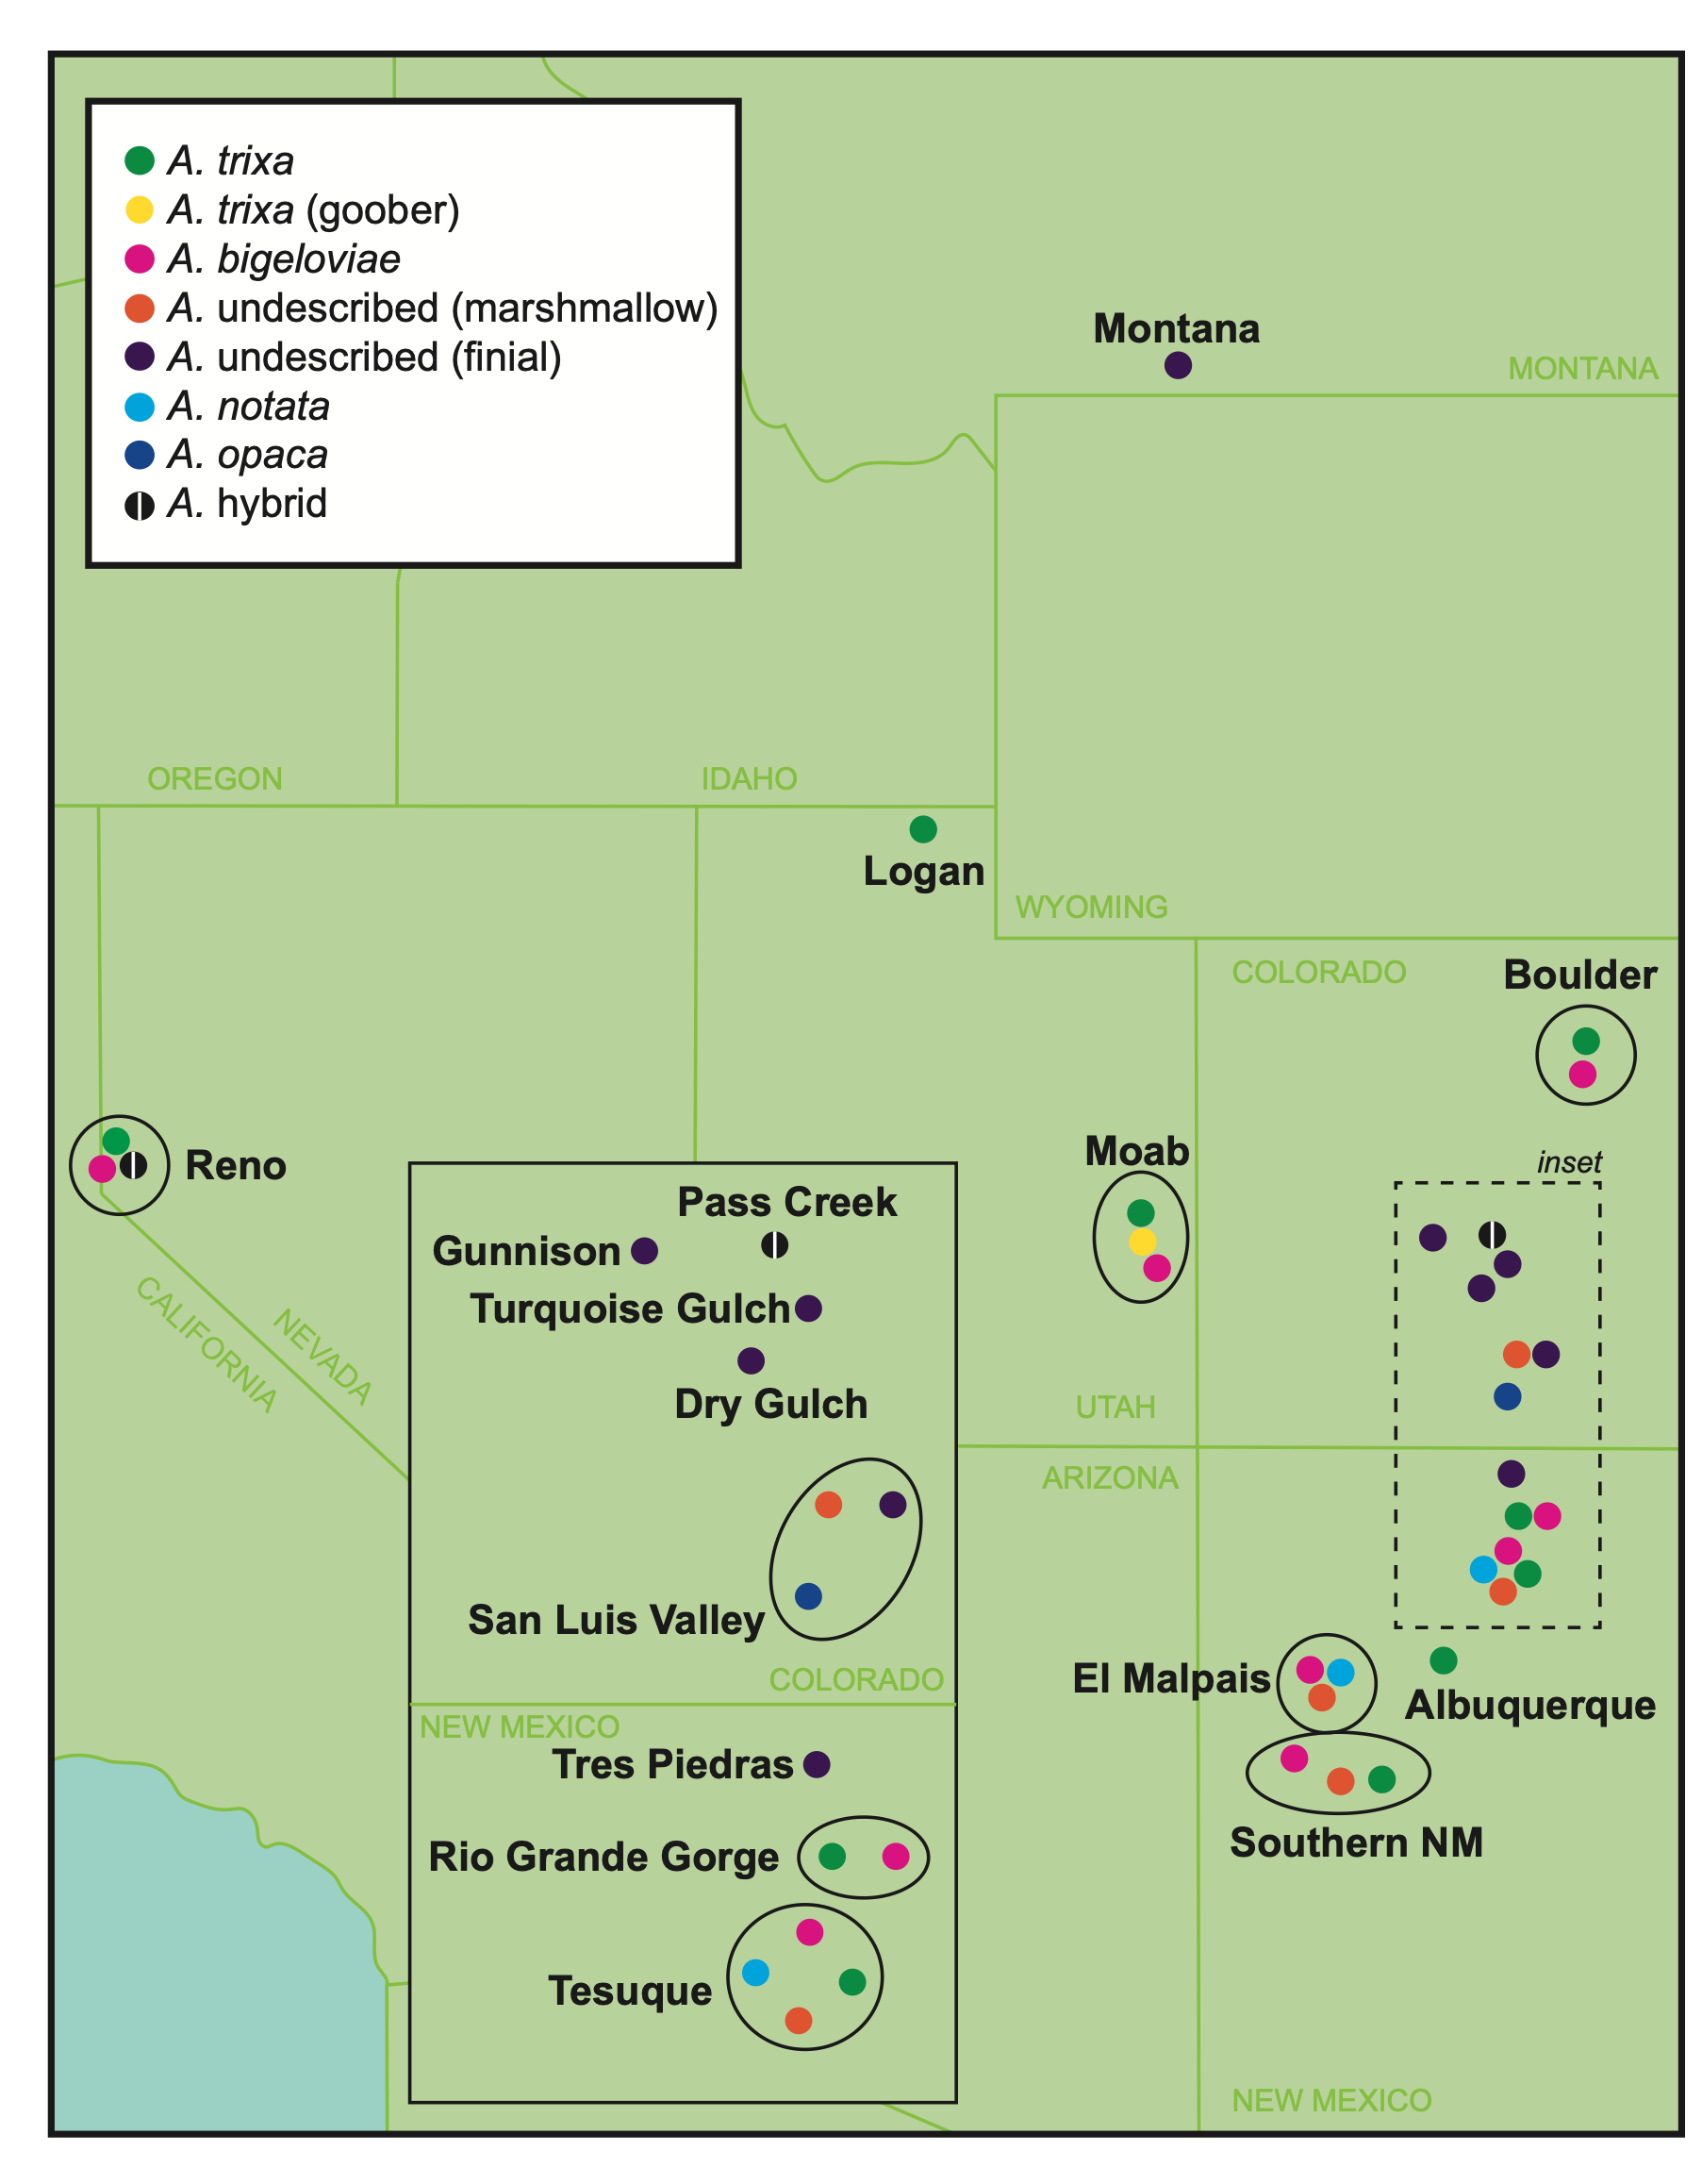
Co-evolution
3 reps per fly indiv
3 reps per wasp indiv
7 reps per plant indiv
= 315 DNA samples
Genotype-by-sequencing:
Illumina ddRAD sequencing

Slide 9
Aciurina

Slide 10
Parameters: m5 M3 n3
hard filter to minimum depth of 5, and minimum genotype quality of 30
filter vcf by the max depth cutoff of 100
3 samples above a 0.6 missing data
cutoff resulting in an acceptable amount of missing data in each sample
Processed variant: from 26023 to 23625

Slide 11
all

Slide 12
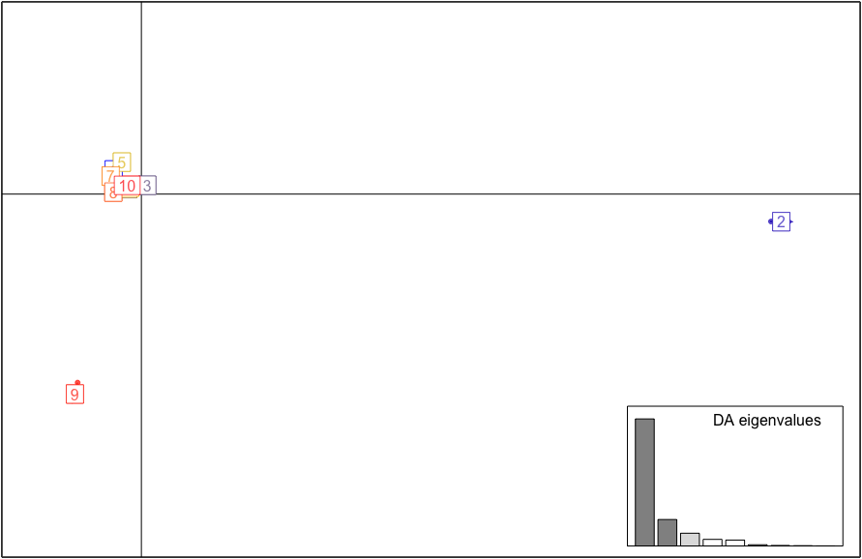
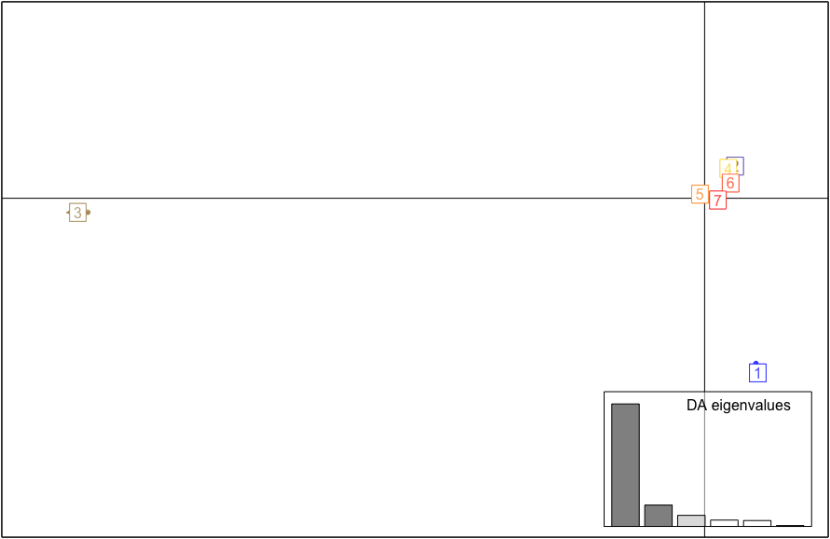
DAPC
1 | Marshmallow
2 | Opaca
3 | Notata
4 | NM Cotton
5 | Utah (S & G) + Reno (S & SH)
6 | CO, UT, MT Cotton
7 | NM + CO smooths
8 | Moab G
9 | Reno
10 | CO F
1 | Reno
2 | NM smooths
3 | Opaca
4 | Utah (S & G) + Reno (S & SH)
5 | Notata
6 | Marshmallow
7 | F & C

Slide 13
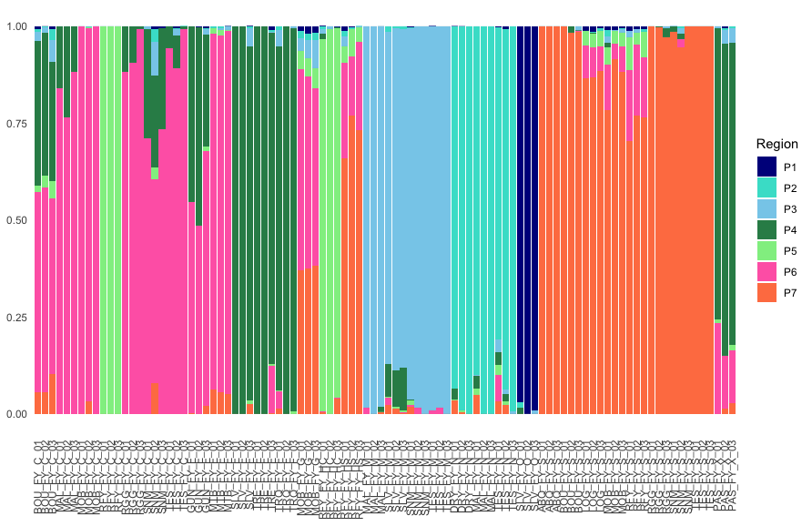

Slide 14
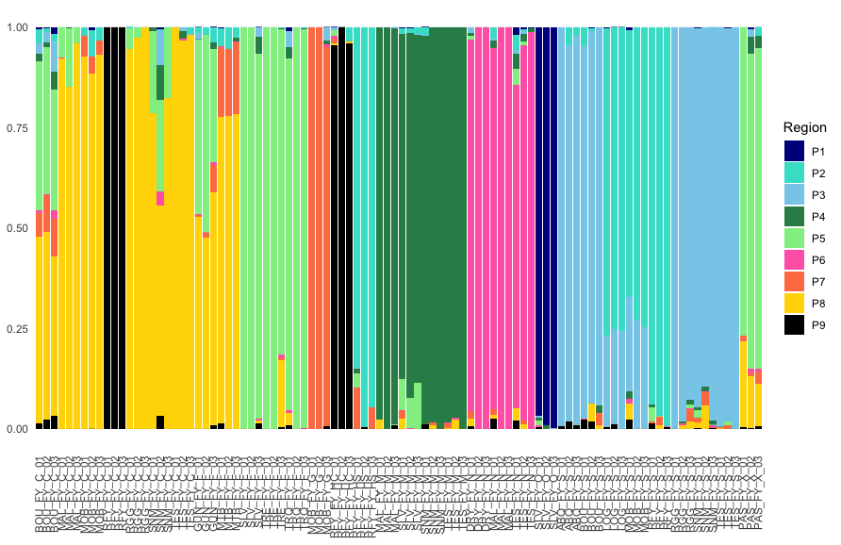

Slide 15
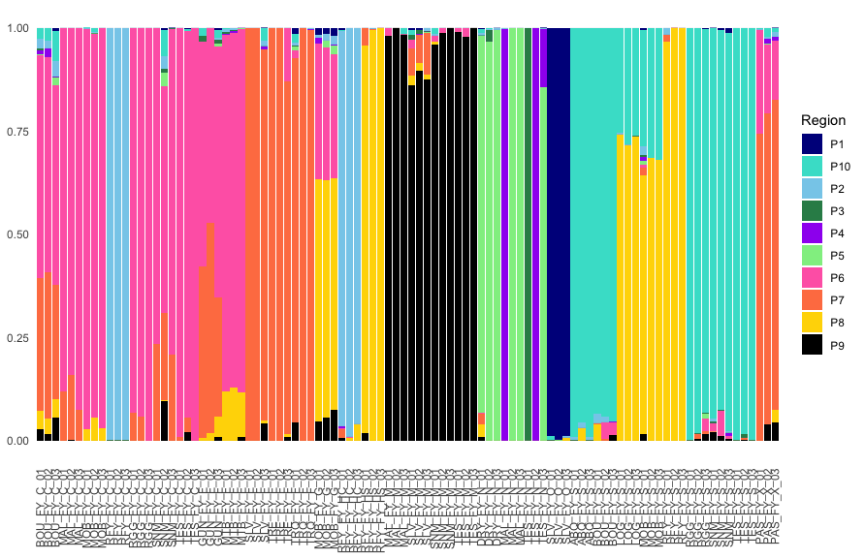

Slide 16
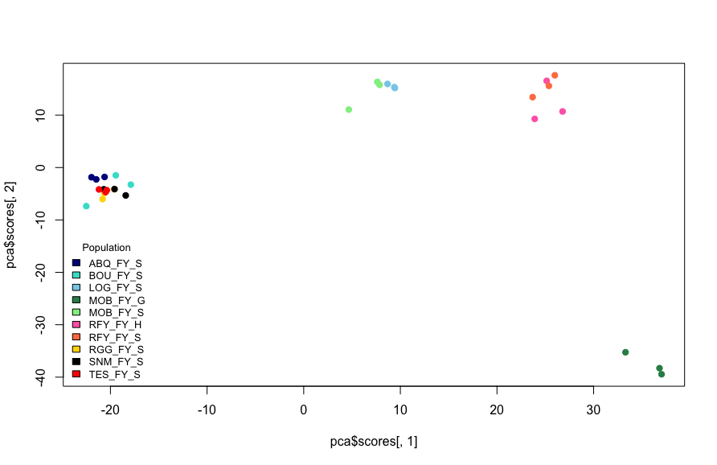
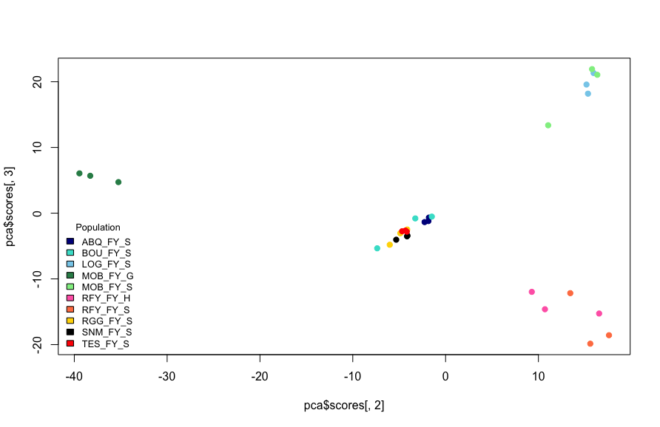
smooth
Processed variant: 52170

Slide 17
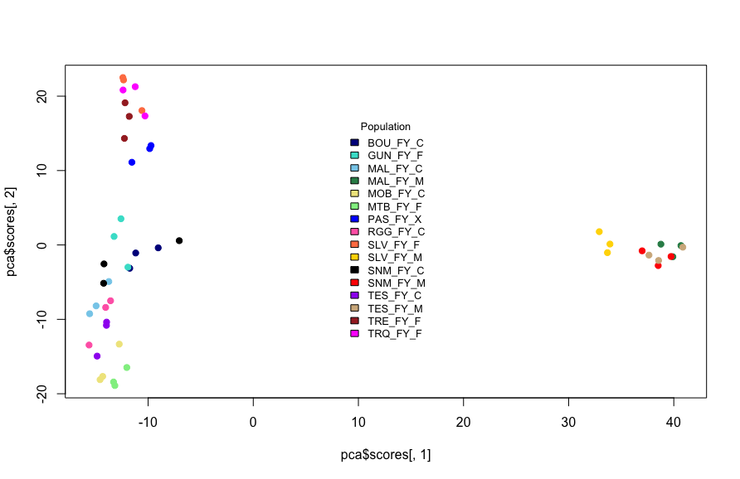
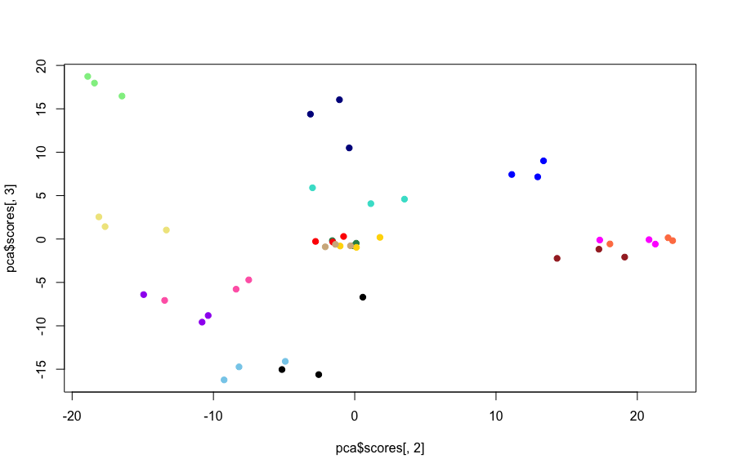
mfc
Processed variant: 41628

Slide 18
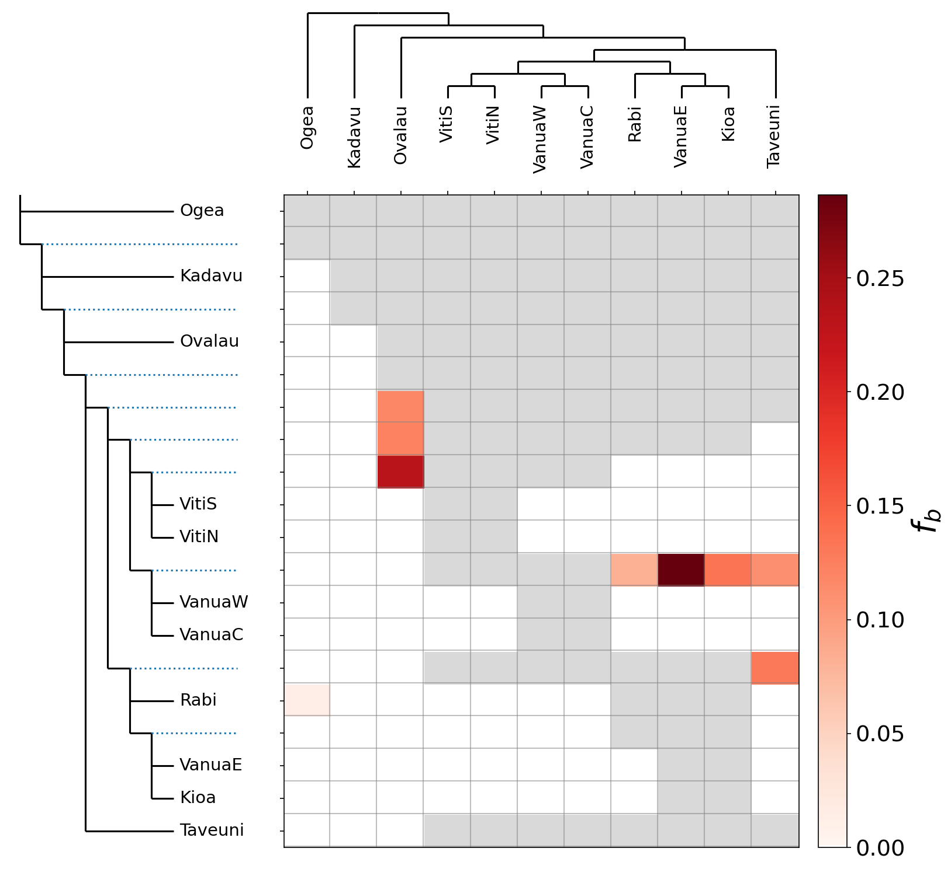
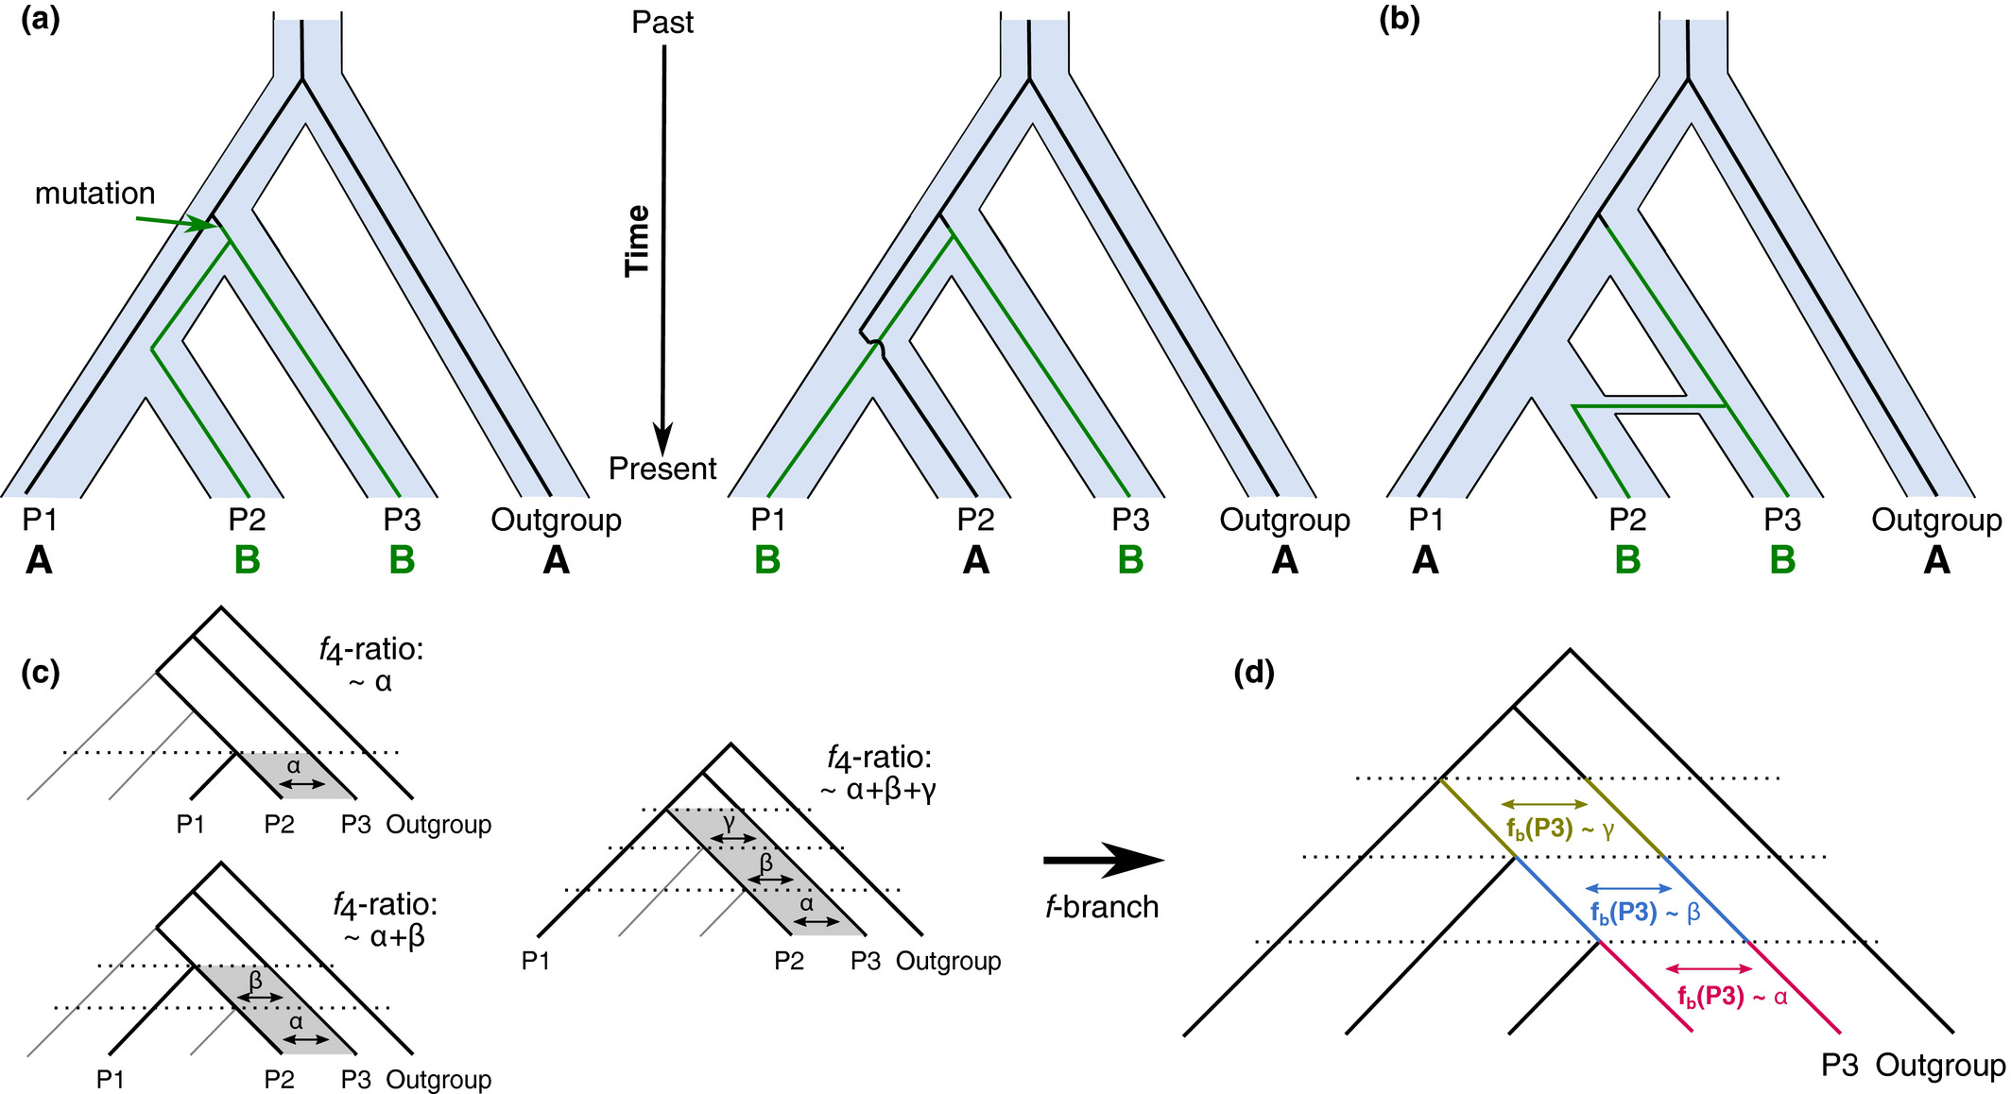
In progress
Dsuite

Slide 19
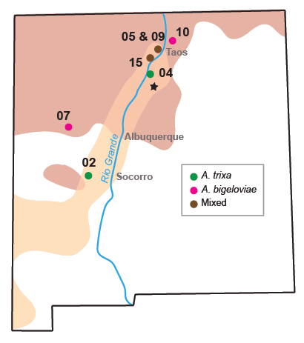
Wasp
Smooth: 2 sympatric, 2 allopatric
Cotton: 1 sympatric, 2 allopatric

Slide 20
Wasp
Smooth: 2 sympatric, 2 allopatric
Stacks de novo assembly
Parameters:m5 M3 n3
Filtered:
Mean depth 44
Min depth 5
Max depth 100
Min genotype quality 30
Alleles outside 0.25-0.75 trimmed (3.23% of all genotypes) “3.23% snps below MAC of 1”
Missing per sample cutoff 0.8, none dropped
80% SNP completeness cutoff (7.66% dropped)
thinned
23,060 SNPs
Cotton: 1 sympatric, 2 allopatric

Slide 21
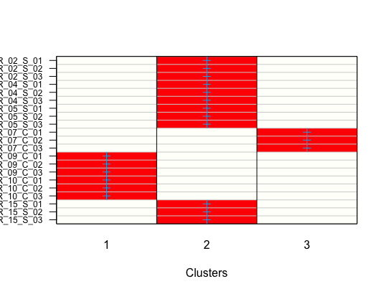
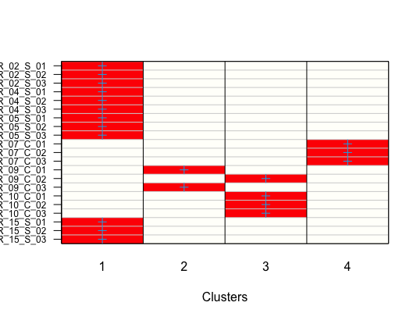
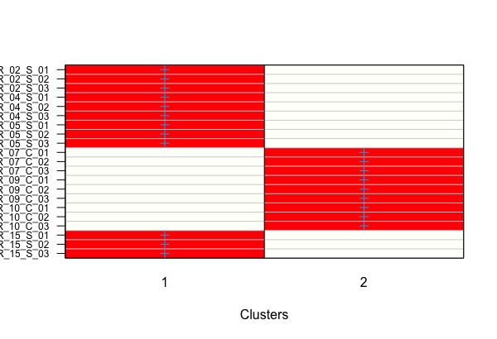
Wasp
DAPC

Slide 22
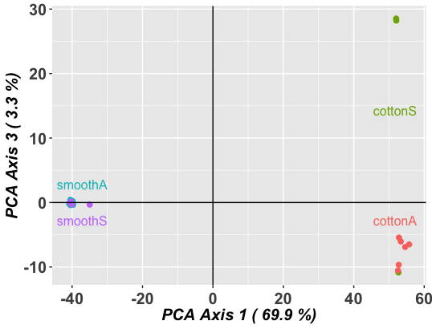
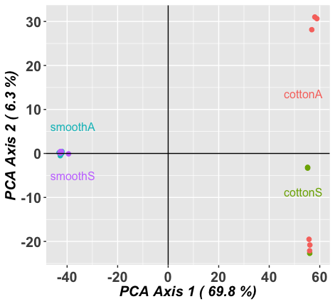
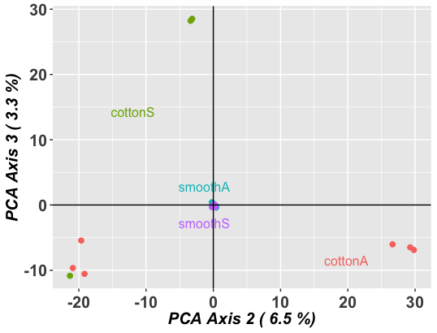
Wasp

Slide 23
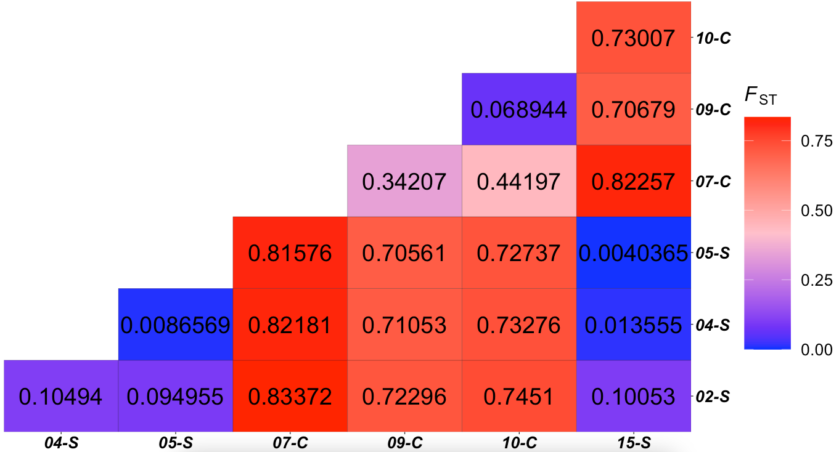
Wasp

Slide 24
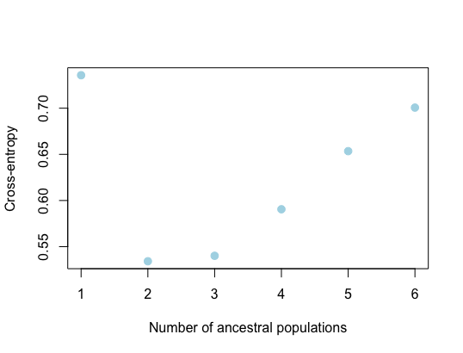
Wasp
structure

Slide 25
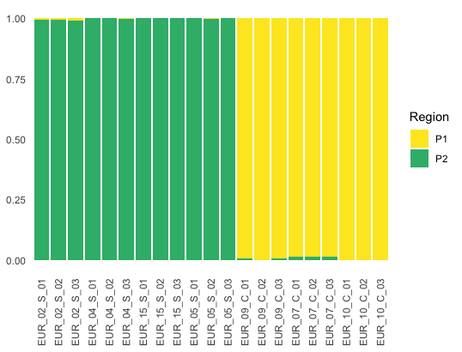
Wasp
smooth
cotton

Slide 26
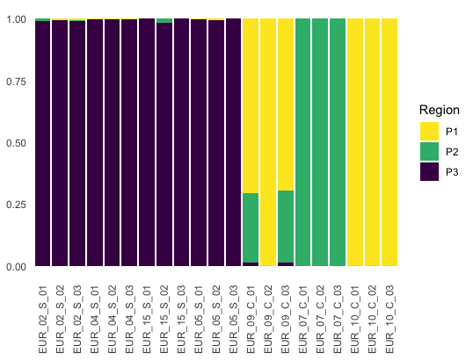
Wasp

Slide 27
Wasp

Slide 28
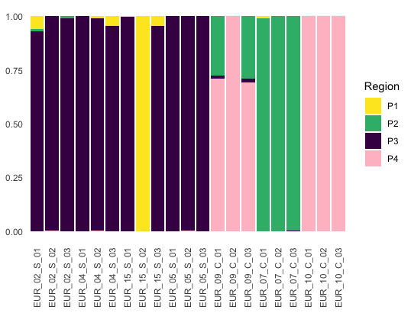
Wasp

Slide 29
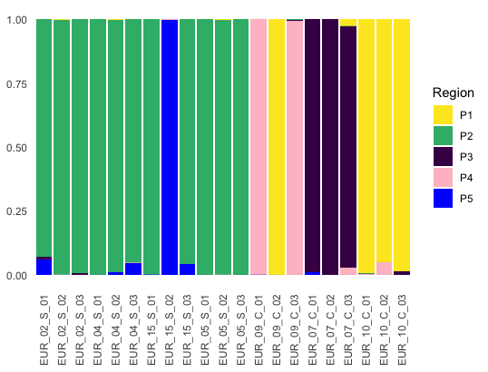
Wasp

Slide 30
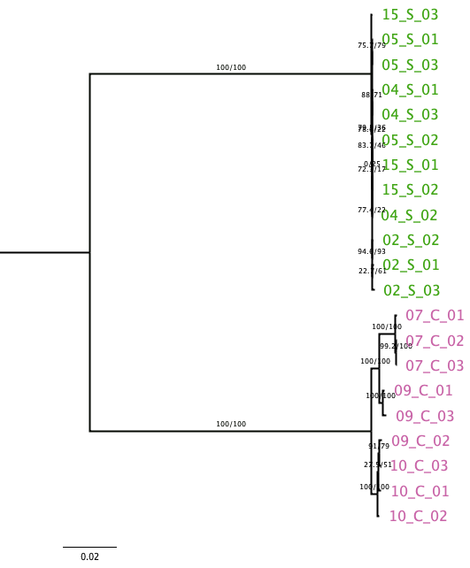
Wasp
smooth
IQTree phylogeny on concatenated fasta (~6000 bp)
K3Pu+F+ASC+R2 (AIC) and 1000 bootstrap 1000 alrt
cotton

Slide 31
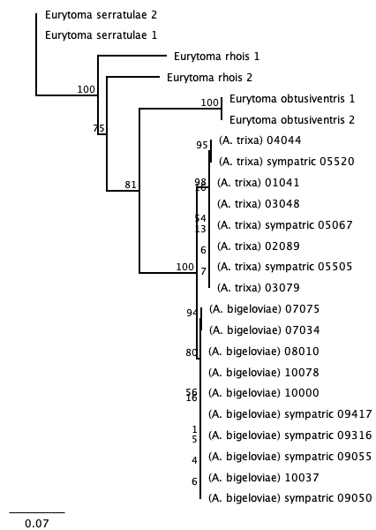
Wasp
IQTree phylogeny on concatenated fasta (~6000 bp)
K3Pu+F+ASC+R2 (AIC) and 1000 bootstrap 1000 alrt
COI

Slide 32
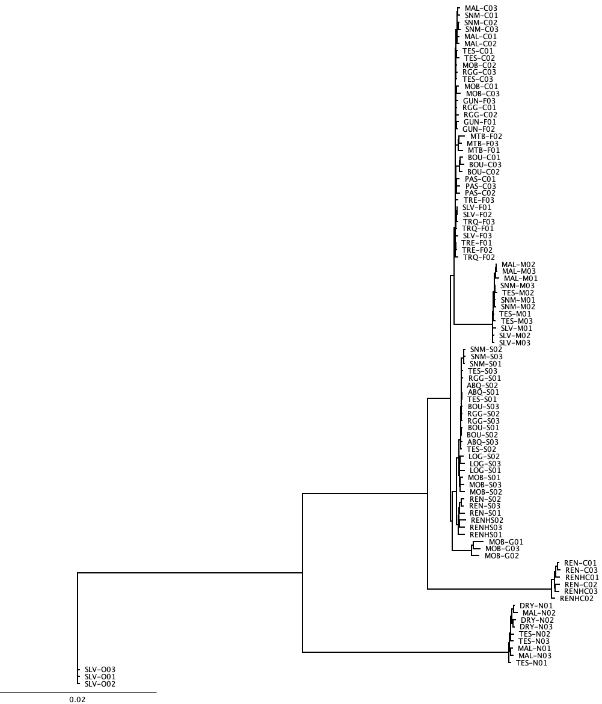
Fly
IQTree
TVMe+ASC+R3 (AIC) and 1000 bootstrap 1000 alrt

Slide 33
Fly
cotton/finial
IQTree
TVMe+ASC+R3 (AIC) and 1000 bootstrap 1000 alrt
marshmallow
smooth
goober
cotton
notata
opaca

Slide 34
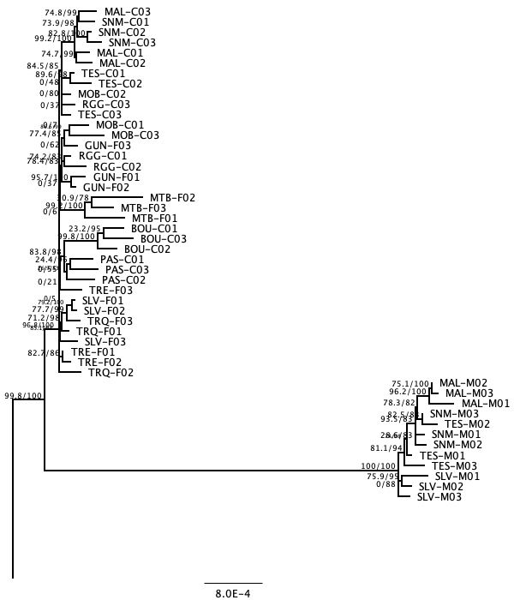
Fly

Slide 35
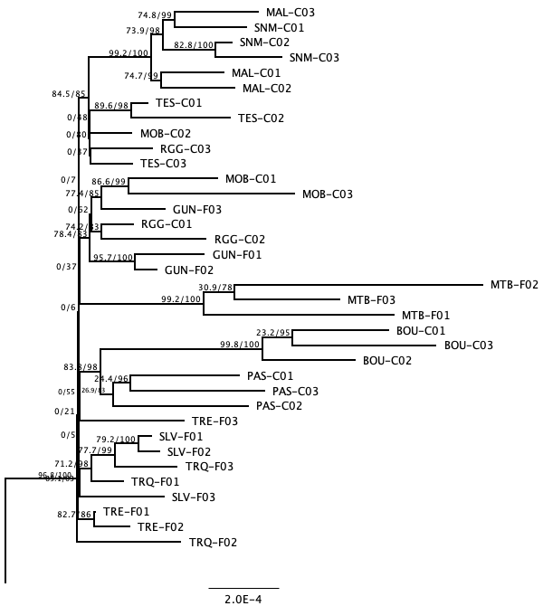
Fly

Slide 36
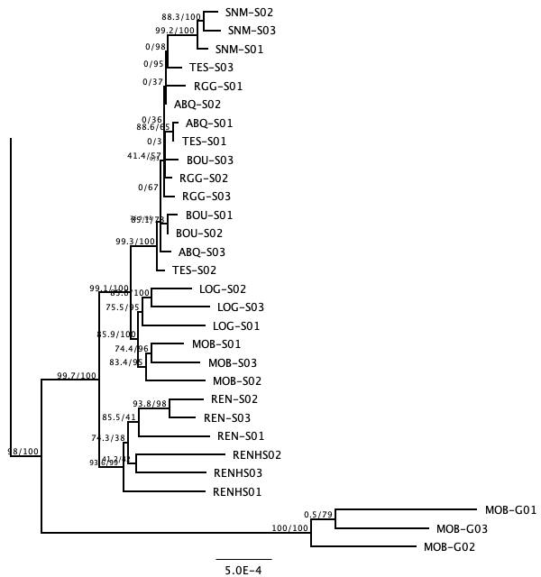
Fly

Slide 37
HAD
COI

Slide 38
HAD
COI

Slide 39

HAD
Updated COI
IQTree
TPM2+F+I+G4 (AIC) and 1000 bootstrap 1000 alrt

Slide 40
Maps?

Slide 41



Background
Aciurina species are flies that induce galls on rabbitbrush plants in western North America. The galls are distinctive between species and so we can record range of the species by gall occurrences.
Galls are poorly understood and we don’t know the main drivers of galling insect speciation – do they differentiate along with their host plant?

Slide 42


A. bigeloviae galls on E. nauseosa var. graveolens in New Mexico
Background
Rabbitbrush (Ericameria nauseosa) is split into several morphological “varieities” that may or may not be genetically distinct. We generally find that Aciurina flies are specialized to specific varieties and so we can predict the range of the fly will match the range of 1 or 2 varieities. We don’t know what drives the evolution of these varieties (they remain reproductively compatible) and what might dictate the extent of their ranges throughout the mountainous west.

Slide 43

Research Questions
Aciurina bigeloviae was originally described as being morphologically variable in wing pattern. However, evidence points not to variability, but to 2 distinct wing morphs that correlate to 2 distinct gall morphologies and different host plants. Genetic evidence now supports that these flies are 2 distinct species.
Is the new species restricted in range by environmental factors that make it less common in the southwest than A. bigeloviae?
Is there a difference in habitat suitability of the fly and its specialist host plant that would prevent the fly from occurring throughout the plant variety’s range?

Slide 44


Data Sources
Soil data was collected from USDA NRCS district surveys compiled in the dataset STATSGO2. I selected soil order and soil particle size as relevant variables due to observations that A. marshmallow occurs in sandy, arid soils.
Order
ex. D = “Aridisol”
Particle Size
ex. 048 = “sandy skeletal”

Slide 45



Data Sources
PRISM climate data collected from 1981-2010 and averaged across each year for each state separately
Maximum Temp
Minimum Temp
Annual Precipitation

Slide 46


Analysis Techniques
Both soil data layers were selected by location for the four corners states. Both were converted into raster layers. Soil order was left with its remaining attributes (A,D,E,I,M,V,water) and soil particle size was reclassified to group together sandy soils (1), loamy soils (2) and clayey and silty soils (0).

Slide 47


Analysis Techniques
For each occurrence point, the data from the raster layers was extracted so that each point has an assigned soil order, particle size, max temp, min temp, and precipitation.
Attribute table was then summarized per selection to get these variable ranges for each species
Each set of ranges was used as conditions to make each raster layer into Boolean rasters (meets condition vs. doesn’t meet condition) and then these layers were added together for each species to create a habitat suitability model. This was then reclassified to show suitable and not suitable for each species.

Slide 48

Results
Aciurina bigeloviae has an extensive range and suitable habitat that is included within the hypothetical plant variety range.

Slide 49

Results
Aciurina marshmallow is much more restricted in range in the southwest. The hypothetical plant variety range matches well to fly habitat suitability, indicating high level of specialization.

Slide 50


Results
However, it doesn’t appear that the two have distinct ranges from one another, just that A. marshmallow falls within the range suitable for A. bigeloviae

Slide 51


